Slide 1

Implementing Communication to IoT Devices in iOS
ARPIT KULSRESHTHA
Mobile Development

Slide 2
Agenda of Session
Introduction to Espressif systems
Setup communication with devices via BLE
Device communication setup to AWS IoT
MQTT messaging between cloud and device
listening and control IoT device with AWS IoT.
Limitations and Challenges.

Slide 3

Teams, Roles and Responsibilities
Embedded Device Programming
IoT Cloud Management and control
Mobile App Development

Slide 4
IoT controllers and microcomputers
For the client sections of IoT applications, a microcontroller or board with a microchip is used. Usually, a high-level programming language, such as C, C++, Python, etc., can be used to programme microcontrollers.
ESP8266
Arduino
STM
ESP32 (ESPressif Systems)
Asus Tinker Board
Raspberry Pi

Slide 5
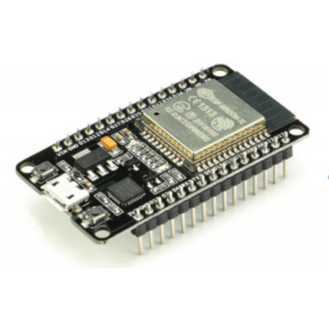
Why ESP32
Microcontroller with a dual-core 32-bit processor, a clock frequency of 160 or 240 MHz and a performance up to 600 DMIPS (It's a measure of how many operations the CPU can perform in a single clock cycle)
Support for dual-mode Bluetooth: “classic” and BLE, Wi-Fi
Wi-Fi mode support: client, access point
Wi-Fi Direct with minimum sensitivity is -98 dBm
Recommended platform for Espressif Systems, AWS IoT, and Google Cloud IoT.

Slide 6
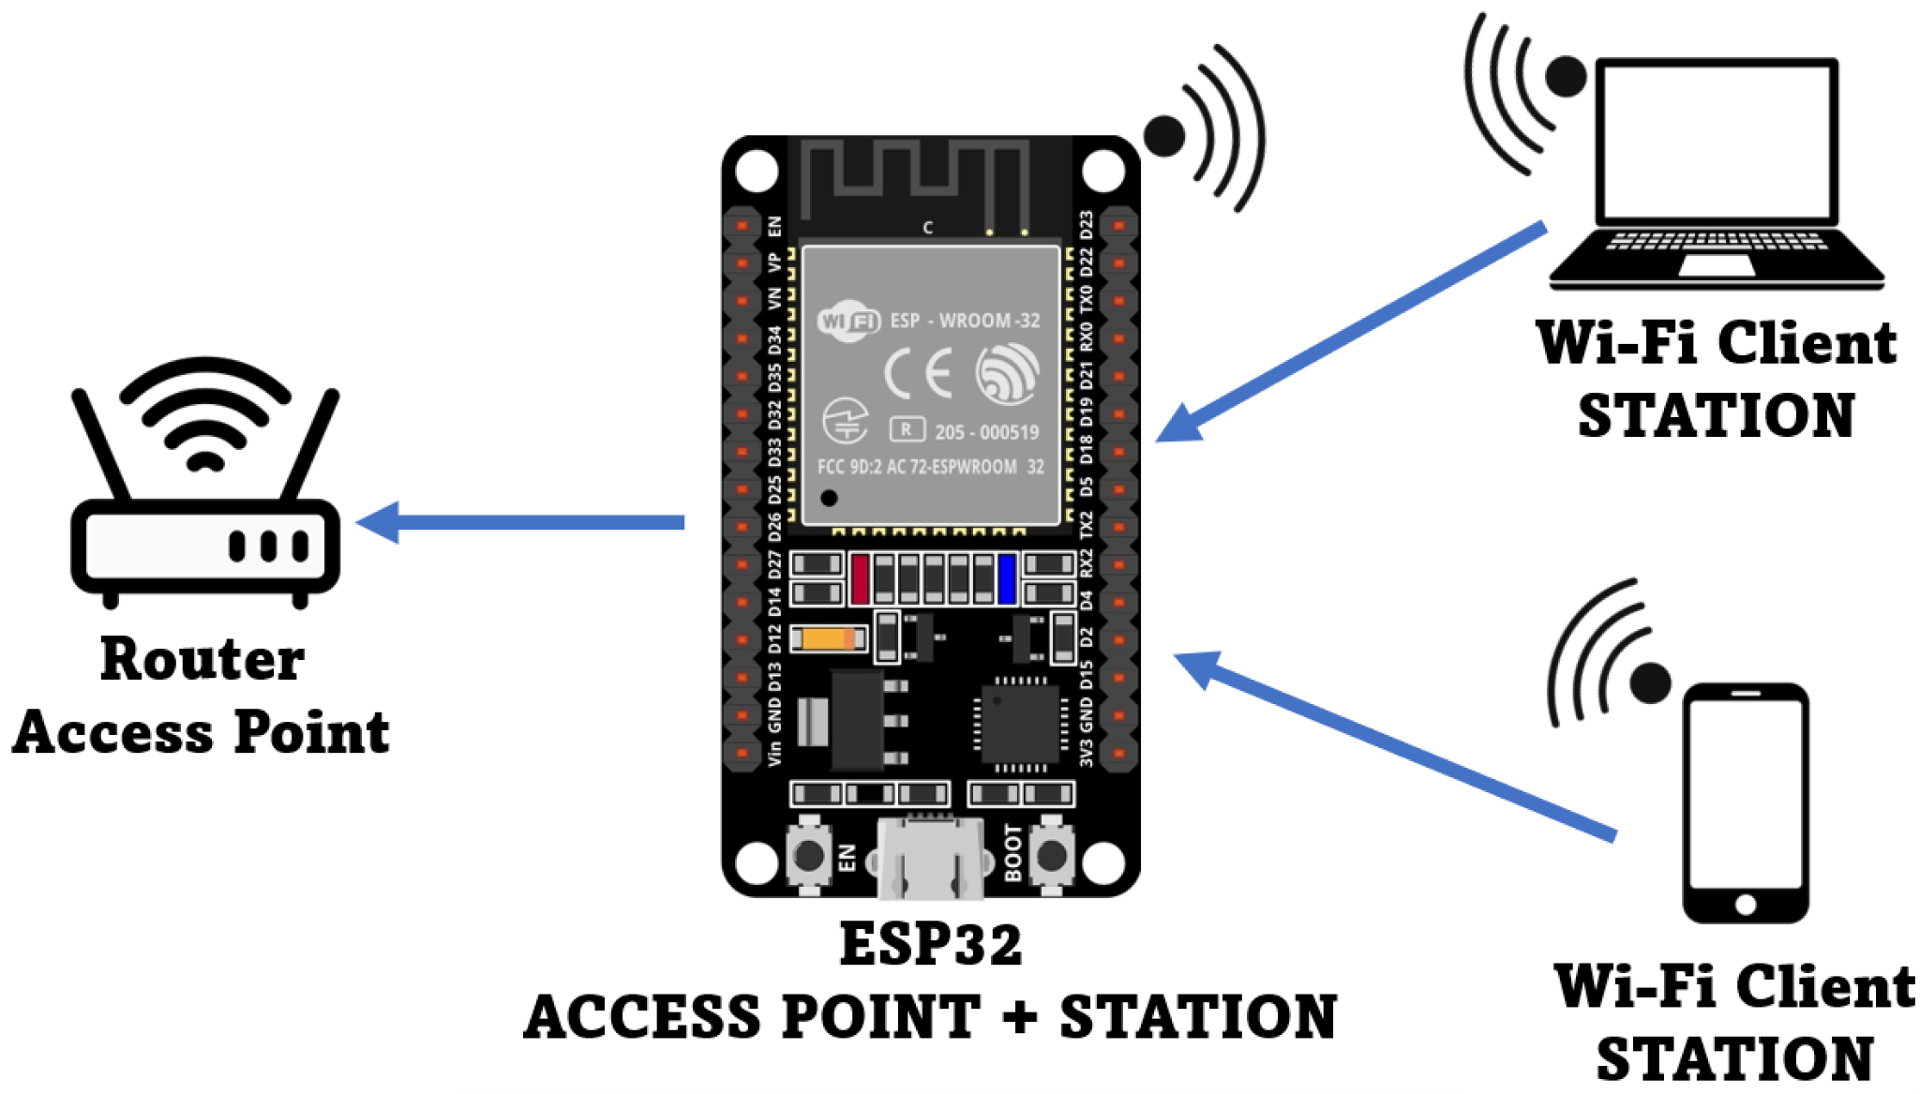
ESP32 Configuration / Setup
Transport Type
BLE
WiFi Access Point
Security Type
0 - No Encryption
1 - Encrypted

Slide 7
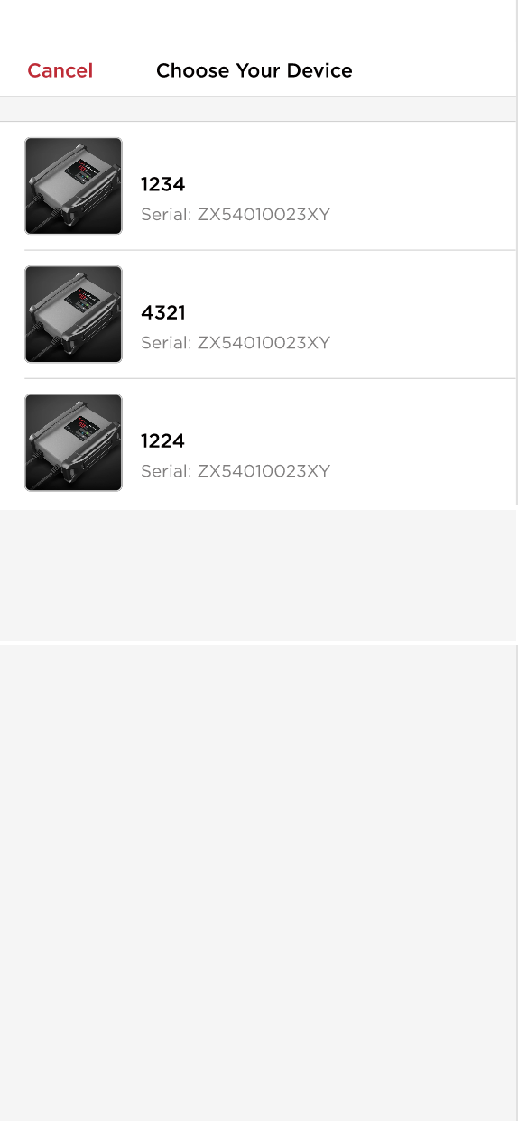
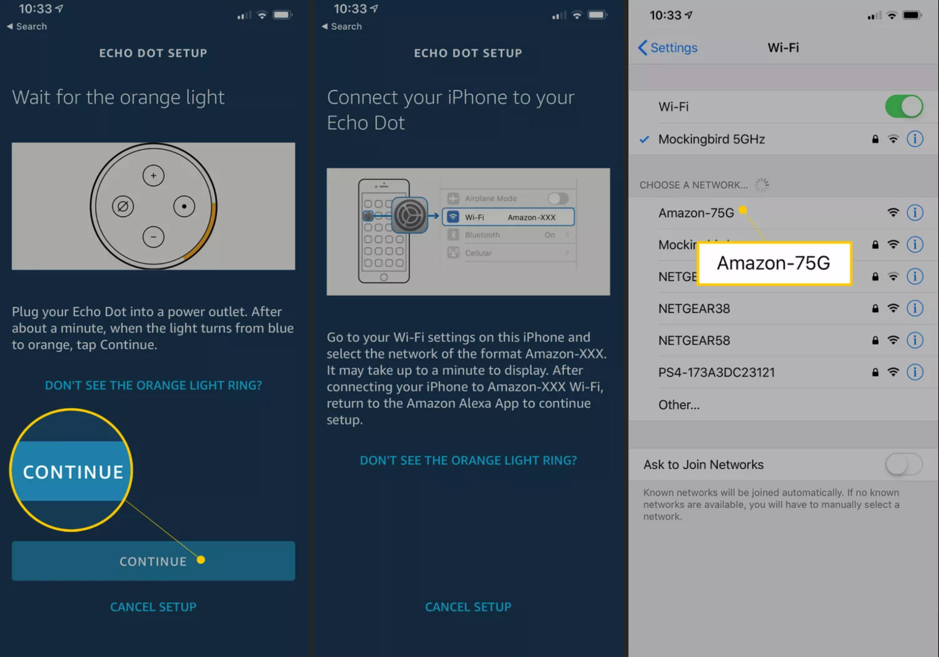
Wifi Access Point
BLE Connect

Slide 8
Steps of Communication to IoT Device (Code)
Scan for BLE or WiFi scan with Service UUID.
Connect with single device.
Send Data to device (Which will help device to configure and connect with AWS IoT).
Provision ESP (Send Wifi SSID and Password) of the router from which device has to connect for internet connection. (this must be last)
After successful 4th step device will auto disconnect from Mobile app and continue to Provision to AWS Cloud IoT further.

Slide 9
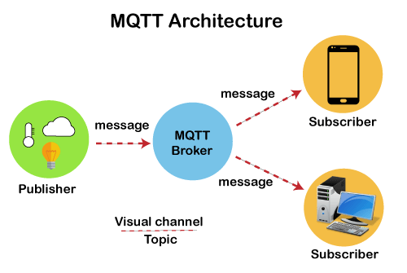
MQTT Protocol
Messaging protocol, or set of rules, used for machine to machine communication.
Extremely lightweight publish/subscribe messaging transport used for IoT Communication.

Slide 10
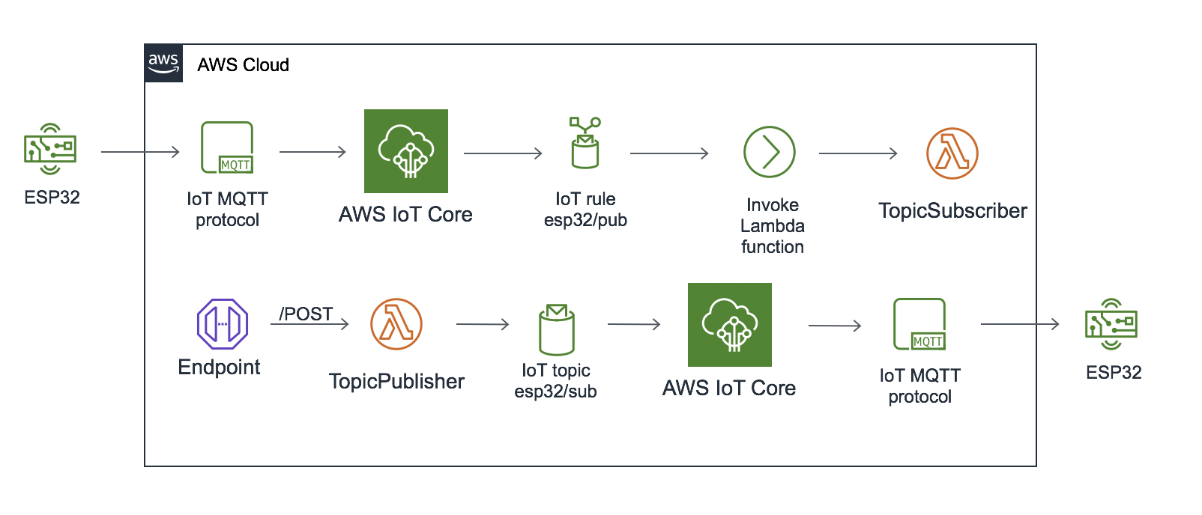
Architecture of Communication IoT Device

Slide 11
Firmware Updates IoT Device
Once hardware is shipped out from manufacturing it is hard to change anything in that.
So it’s really important to give capabilities of Firmware update.
There could be two ways, If IoT MQTT is not connected to cloud or not yet setup (in case of ongoing development) then Firmware updates can be transferred via BLE.
Otherwise if MQTT is setup, It can be triggered via admin from cloud or mobile app via user.

Slide 12
Challenges And Limitations
If you want to implement this on cross app development platform then no direct libraries are available and you have to go for bridging / plugins to respective Native solutions.
Most of the latest microcontroller chips not able to detect 5Ghz Wifi connections bands, which is still a technology limitations. That needs to be informed well to user in advance via UI on mobile devices.

Slide 13
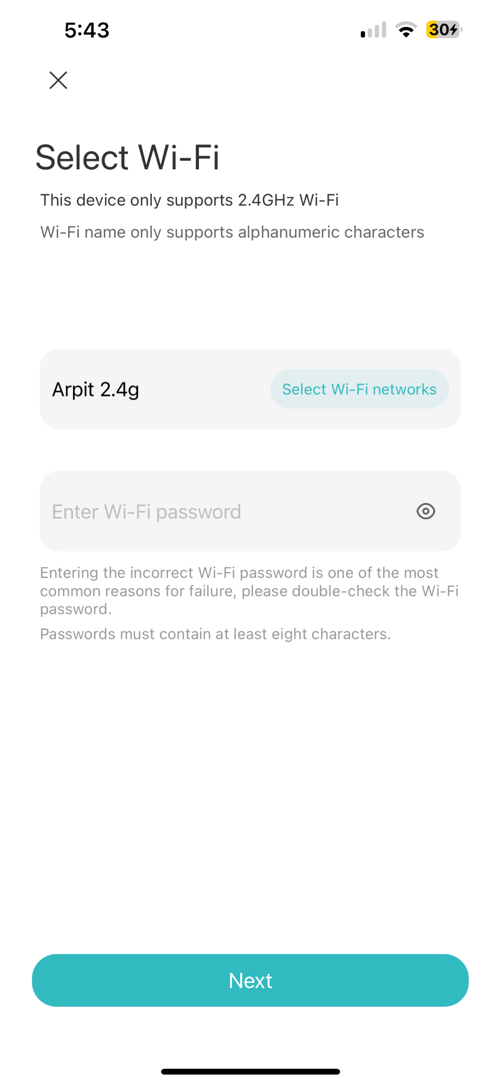
Proper communication that device is able to connect with 2.4GHz.
Inability to show nearby availability of wifi connections in iOS. We can only show from which mobile is connected.
How to handle if Wifi Password input is wrong?

Slide 14
Thank you
Notes:
Activity 1
- Study
Make a conscious effort to improve attention to detail everywhere. Wherever you go, look for things to recall later. When you're shopping look for three things to study. Take 15 to 20 seconds to study each object. After returning home, write down specific things about the objects. Make notes of the size, the shape, the color.
Activity 2
- Recollection
People tend to get careless about the things in which they are familiar. Complacency especially during routine actions does not exercise the mind. Make a point to look for details and notice things as often as possible. Have you noticed the number of steps you need to climb from the ground to reach 3rd floor and 4th floor at QBurst.63,85)

